Slide 1
NK Autoparts
07-03-2017
Presentation of the
NK brand and product range

Slide 2
What is NK?
NK is SBS Automotive’ s brand for B2B customer segment
NK is the only brand covering our full product range
NK is an old brand with roots long back in the 20th century
NK has a strong market position in the aftermarket in many countries, especially in Scandinavia, Germany and Russia
NK is represented by customers all over Europes

Slide 3

Part types
The NK Range covers automotive wear and tear replacement parts
The NK range contains product groups which in average are changed one or more times in the life cycle of a car
The NK range does not include parts which are mainly replaced due to accidents, poor maintenance etc. such as body or interior parts

Slide 4

Geography
The European vehicle park – from Reykjavik to Athens
The vehicle park in Russia and former Soviet Union countries
  Except parts for local cars with specific market and price relations (LADA)
  Except parts for cars that are only available in a limited number and narrow geographical area

Slide 5

Vehicle types
Passenger cars
Light commercial vans up to 3.5 t.
All makes and models - no matter of country of origin
From 1980 until today - dependant on product group
Exceptions:
  Parts for local cars with specific market and price ralations (LADA)
  Parts for cars that are only available in a limited geographical area
  Special cars (Ferrarri, Lamborghini etc.)

Slide 6
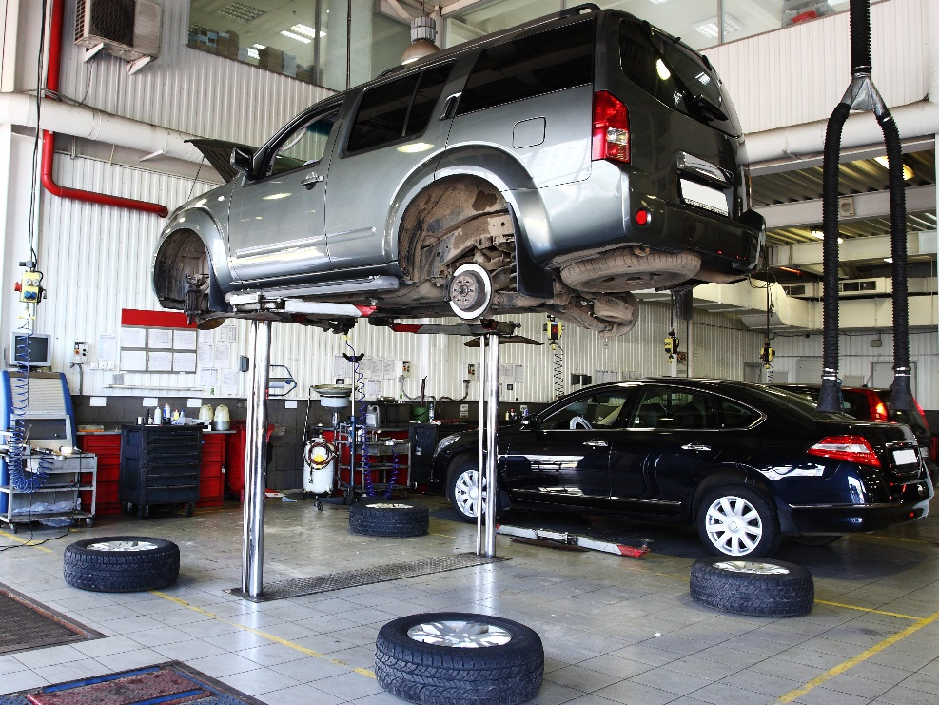
Market Segmentation
NK products are interchangeable parts used by the independent aftermarket (IAM) for repair use
IAM = the market that is not controlled by the vehicle manufacturers and their distribution network (OEM)
The IAM mainly makes service and repair work on cars older than 4-5 years

Slide 7
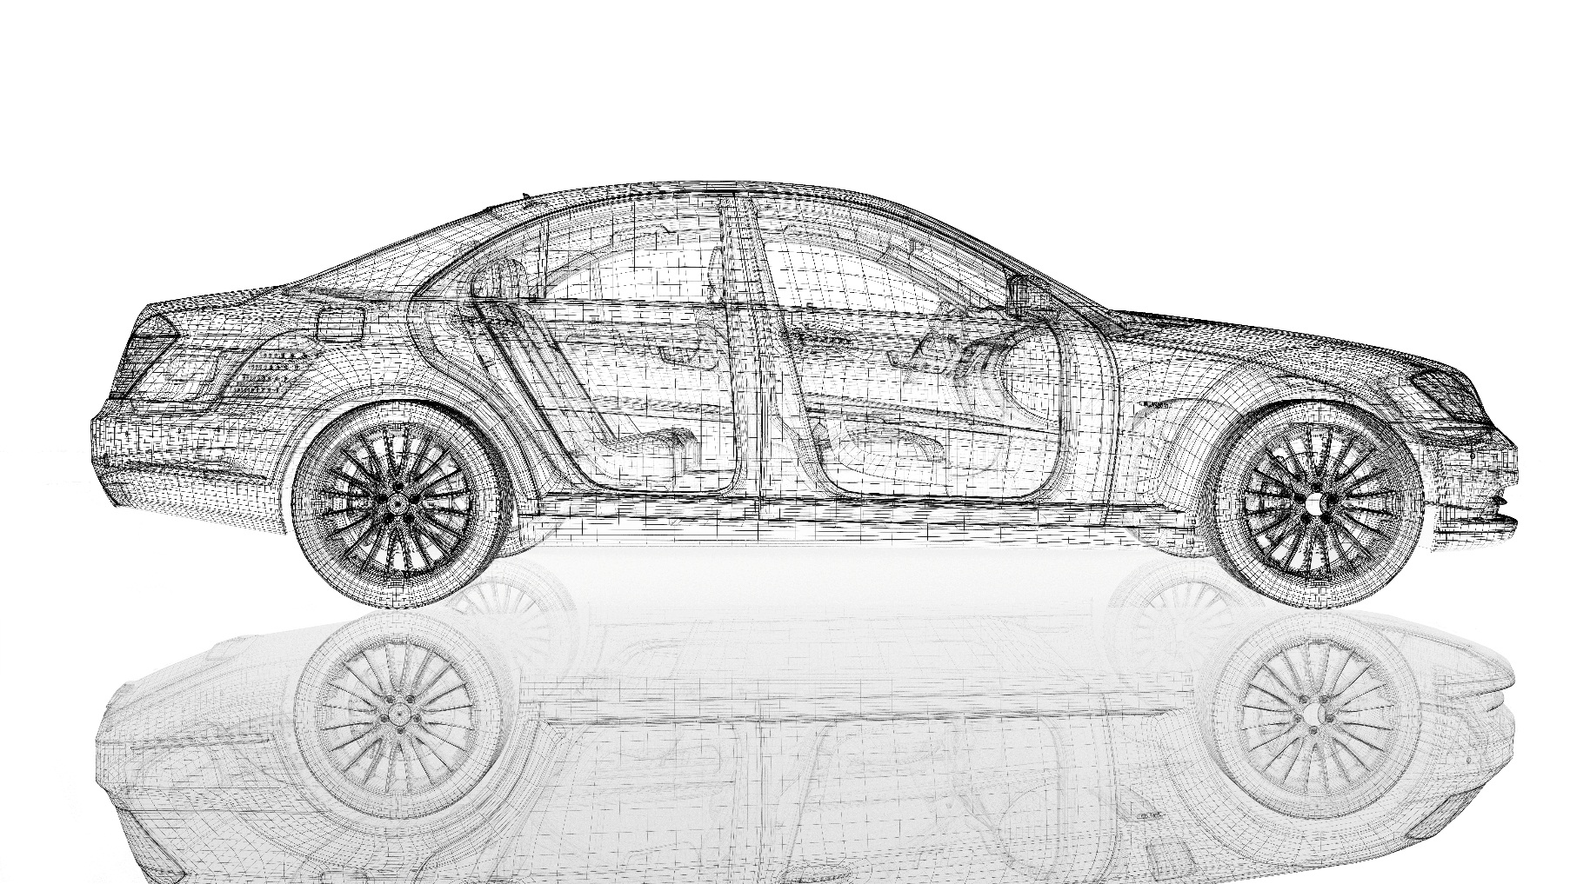
Brake parts
Discs
Pads
Calipers
Drums
Shoes
Hoses
Cylinders
Cables
ABS sensors
Accessory parts etc.
Brake parts
Brake parts

Slide 8
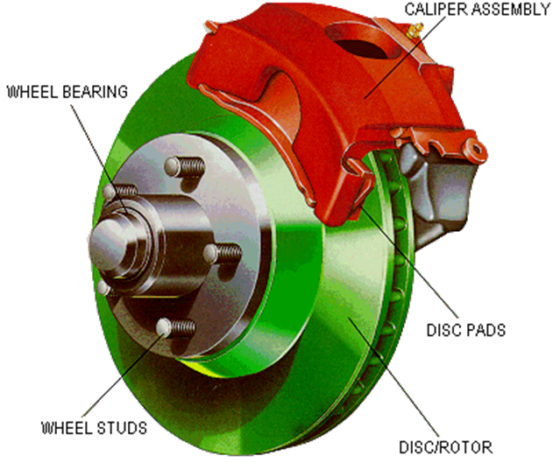
The disc brake system
http://www.youtube.com/watch?v=Mmls5foCor0

Slide 9
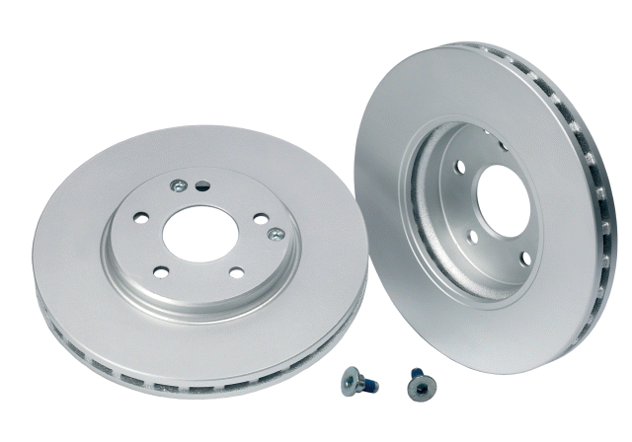
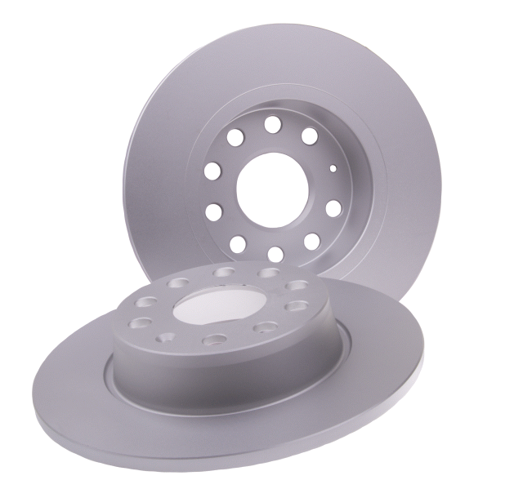
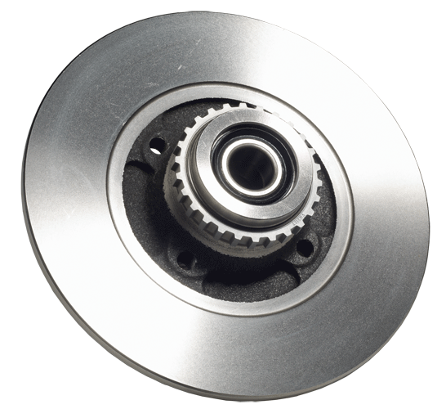
Brake discs
High Carbon
Standard
Coated
With ABS and bearing

Slide 10
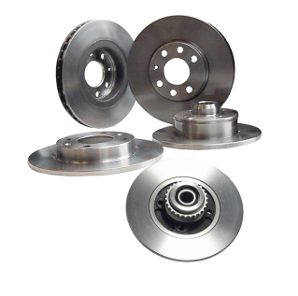
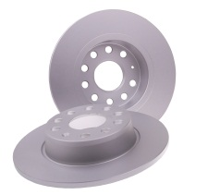
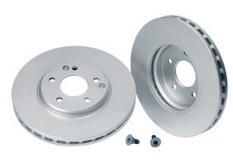
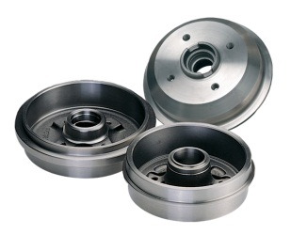
Brake discs – range options
Program | Characteristics | Coverage | Article numbers
Standard | Greased Standard cast composition | European car parc >90% Passenger cars and LCVs | > 1400 ref. numbers
Coated, standard | Spray coated Standard cast composition | Medium/premium models | > 900 ref. numbers
High Carbon | Spray coated Carbonized cast composition | Medium/premium models | < 100 ref. numbers
Drums | Greased Standard cast composition | European car parc >90% Passenger cars and LCVs | 500 ref. numbers

Slide 11
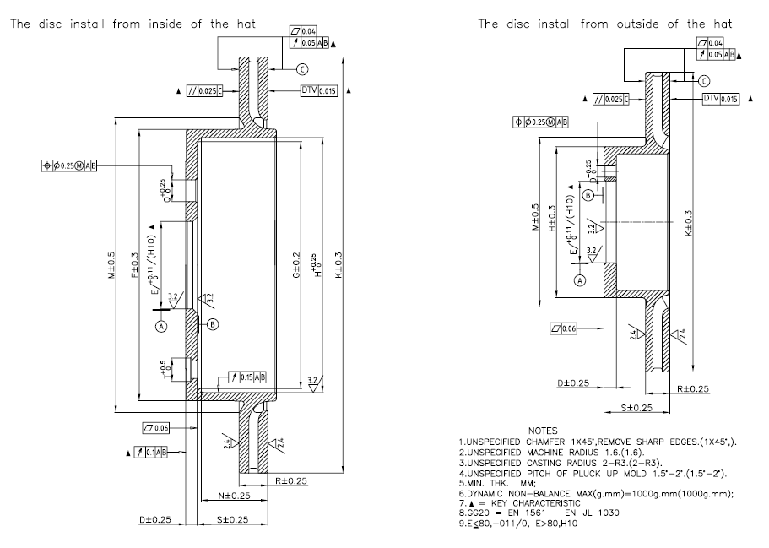
Brake discs – dimensions & tolerances
DTV | Max. 15μM
Run-Out | Max. 50μM
Flatness, brake surface | Max. 40μM
Roughness, brake surface | Max. 2,4μM
Unbalance | Max. 100 gcm
Iron | Remaining

Slide 12
Brake discs - composition
Chemical composition | Standard GG 20 | High Carbon GG 15
Carbon (C) | 3,0 – 3,5 | 3,60 – 3,90
Silicium (Si) | 1,9 – 2,3 | 1,60 – 2,30
Manganese (Mn) | 0,6 – 0,9 | 0,40 – 0,80
Chromium (Cr) |  | 0,10 - 0,25
Molybdenum (Mo) |  | Max. 0,20
Nickel (Ni) |  | Max. 0,10
Copper (Cu) |  | 0,15 - 0,60
Sulfur (S) | Max. 0,10 | Max. 0,10
Phosphorous (P) | Max. 0,12 | Max. 0,12
Titanium (Ti) |  | Max. 0,03
Vanadium (V) |  | Max. 0,10
Iron (Fe) | Remaining | Remaining

Slide 13
Brake discs – cast quality
Mechanical properties | Standard GG 20 | High Carbon GG 15
Hardness | 190 – 230 HB | 150 - 210HB
Tensile strength | Min. 200N/mm² | Min. 130N/mm²
Microstructure
Matrix | > 85% pearlite Max. 1% carbide | > 85% pearlite
Graphite | Form: I Distribution: Mainly A-type. Length: 3-5 | Form: I Distribution: Mainly A-type. Length: 3-5

Slide 14
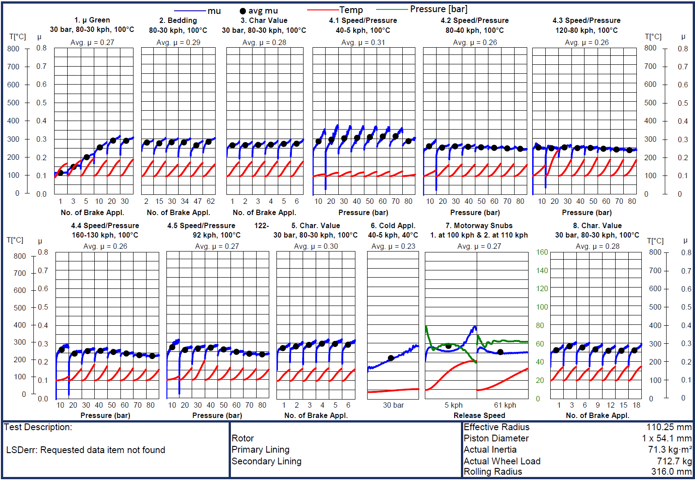
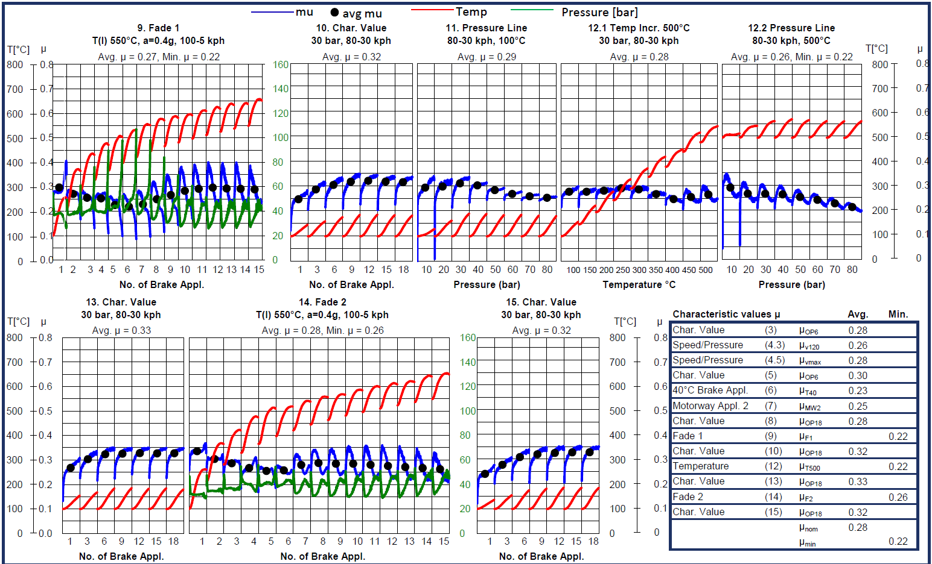
Brake discs – ak master test / Dyno
Benchmark:
Almost as good as OE
As good as Brembo
Better than most other IAM discs

Slide 15
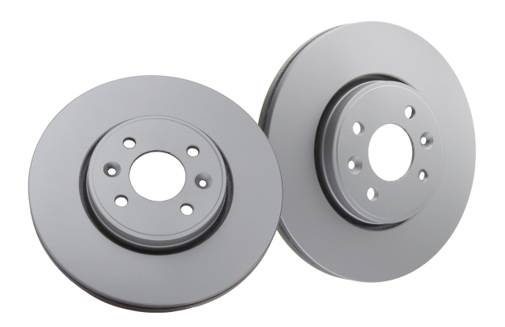
Coated brake discs
Water based chromium-free aluminum zinc paint
No health, safety or flame hazard
Meets REACH and other EU legislation
No organic solvents (chlorine, benzene, halogen)
Spray coated
Thickness < 20µ
Coated brake discs:
Visual advantages
Faster fitting
”Green”: No degreasing

Slide 16
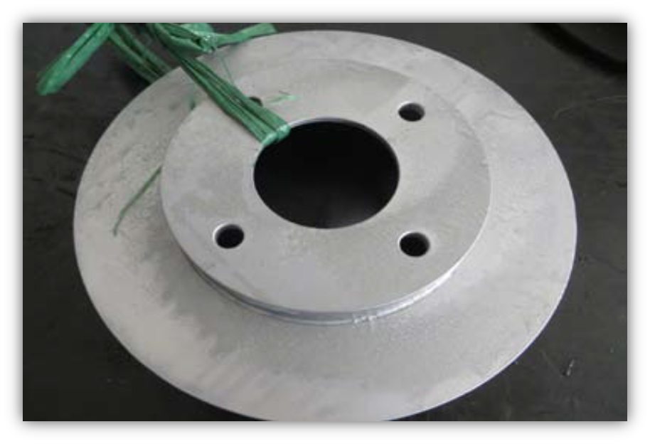
Brake discs coating
Salt spray tested
After 144 hours: No signs of surface rust

Slide 17
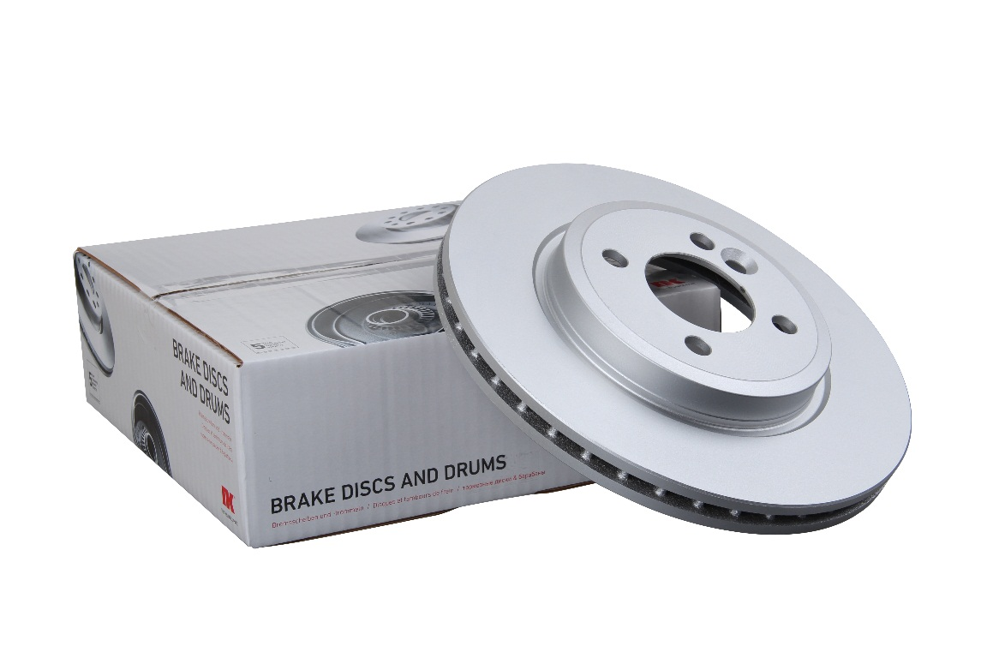
Brake discs – box concepts
Strong, taped boxes
Up to 25 sizes according to purchase
Minimized air – optimized strength
Packed as sets or pcs
Artwork according to customer requirements
Product label according to customer’s specification
Fitting instruction: NK standard or customer’s own

Slide 18
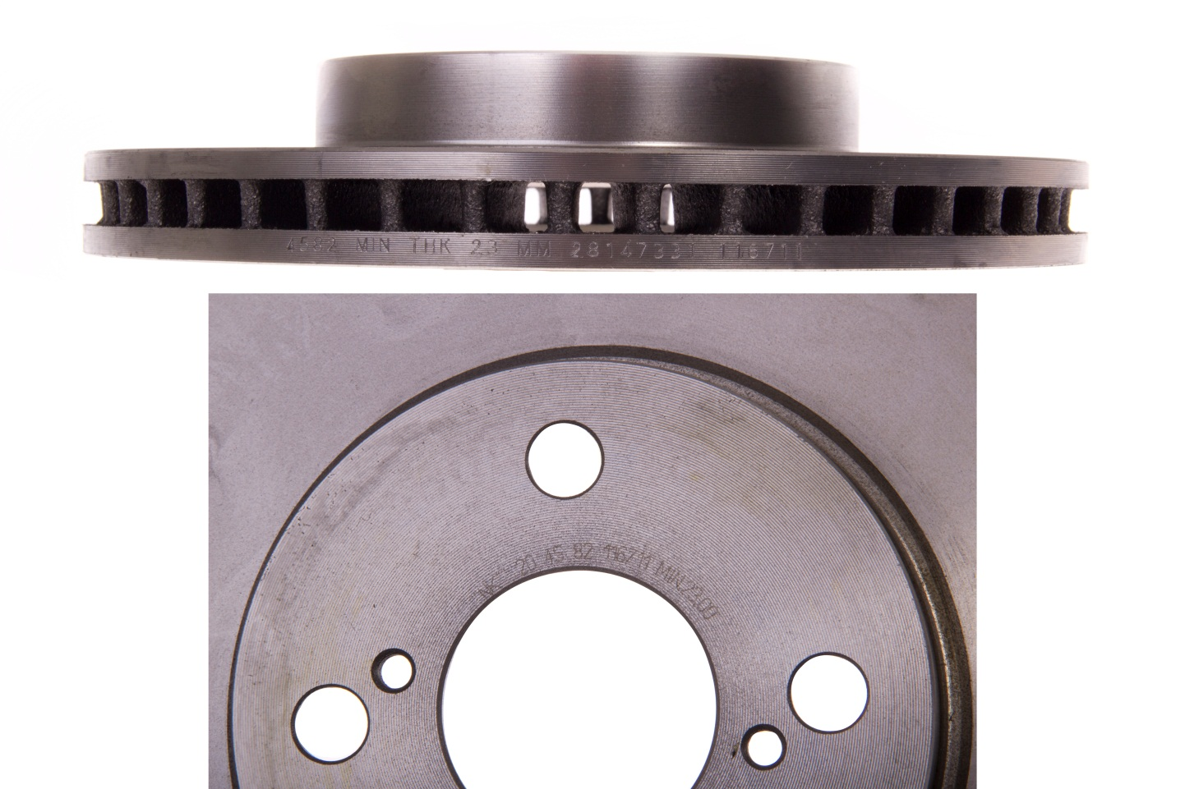
Brake discs – product marking
Edge marking
Standard marking on all discs
Manufacturer’s code
Batch code
NK code
Min. thickness
Top marking (individual)
According to individual customer needs,
such as:
Customer reference number
Customer logo

Slide 19
Brake discs – fitting instruction

Slide 20
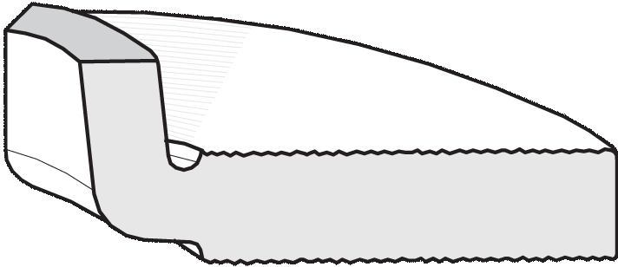
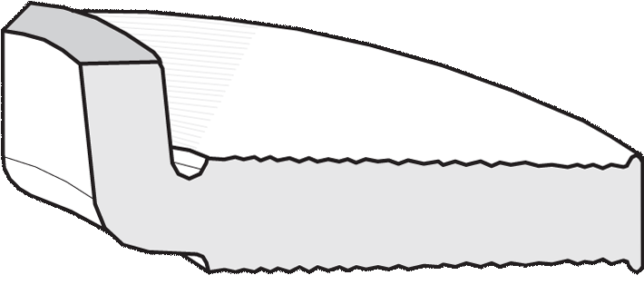
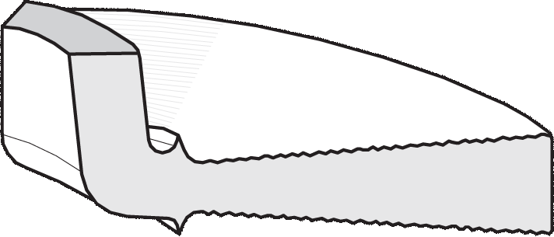
Brake discs – trouble shooting
Check the brake disc regularly for condition and wear. We recommend that this should be done when replacing the brake lining.
This check will show if the brake needs to be
changed.
Normally worn disc
Small regular grooves.
Can be reworked as long as the thickness after the reworking is well above the minimum thickness.
Brake disc with deep grooves
We recommend replacement.
Conically worn brake disc
This must be replaced by a new brake disc.

Slide 21
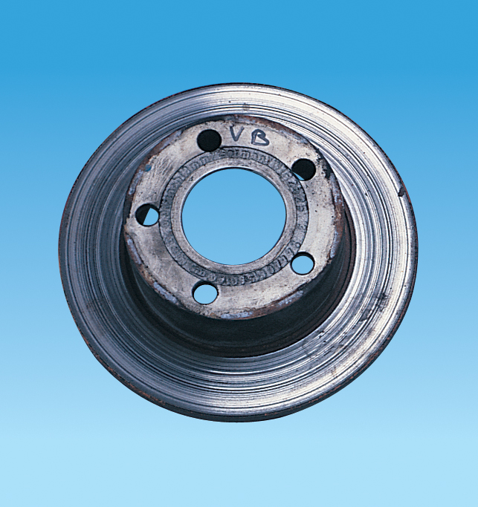
Brake discs – trouble shooting
Grooves on surface
Symptoms: Noise and judder during braking.
Grooved brake surfaces reduce the brake capacity and efficiency.
Grooves are normally caused by brake pads that are worn below the minimum thickness – in worst case down to the metal part of the pad.
Grooves may also be caused by use of wrong type of brake pad.
Check and replace the pads to avoid same problem in the future. Change or rework the disc.

Slide 22
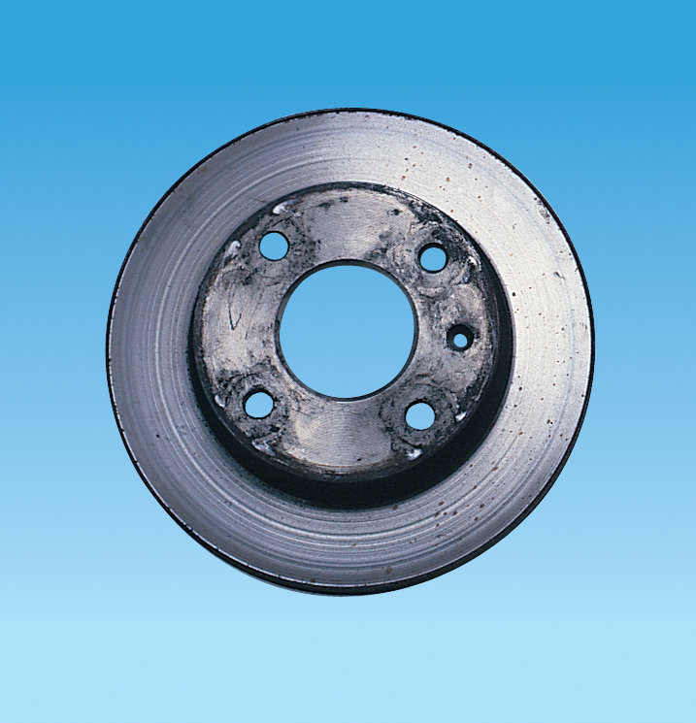
Brake discs – trouble shooting
Excessive Disc Wear
Excessive disc wear may cause noise and judder.
If the disc is worn more than is normal:
Hard driving,
Caliper malfunction.
Check the brake caliper.

Slide 23
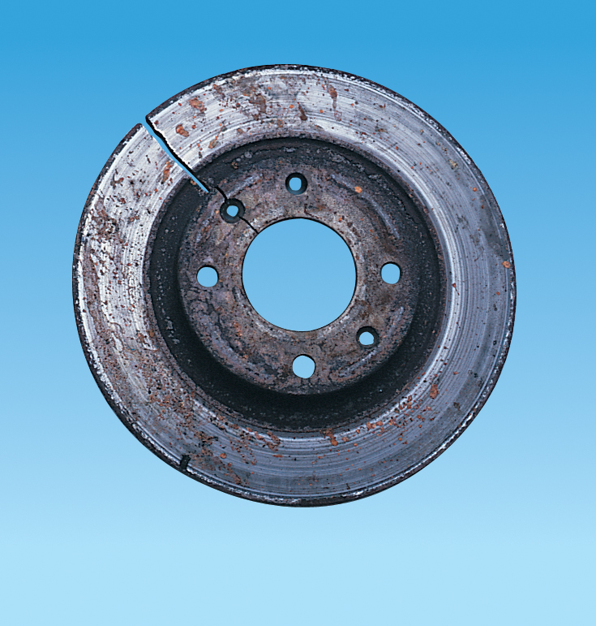
Brake discs – trouble shooting
Cracking
Cracks in the brake disc surface leads to braking noise and inefficient braking.
Cracking can normally be related to thermical reactions due to frequent and excessive changes in disc temperature as a consequence of emergency brakings.
Replace the disc.

Slide 24
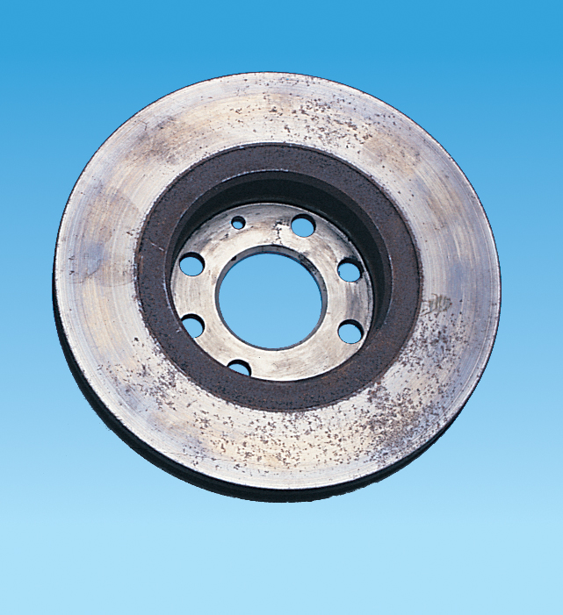
Brake discs – trouble shooting
Corrosion
Corrosion can be registered as intermittent noise from the brake disc combined with reduced braking efficiency.
Too early corrosion of the brake disc may be caused by malfunctioning of other components in the disc brake system or infrequent use of the car.
Especially rear brake disc systems are susceptible to corrosion as the most of the braking pressure is on the front axle.

Slide 25
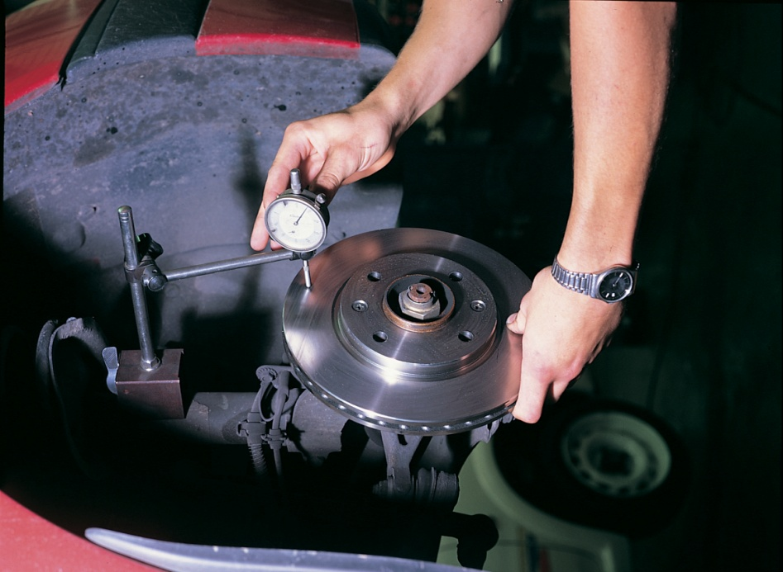
Brake discs – trouble shooting
Run-out
Disc run-out is the major cause of disc braking problems.
Run-out causes steering vibration and increase in pedal stroke.
Run-out is in most cases caused by incorrect fitting and not by faulty production of the brake discs.
The disc run-out should be measured after fitting (follow SBS fitting guide and vehicle manufacturer’s instructions), and can be measured with a micrometer.
Excessive run-out at this step may lead to thickness variations of the braking surfaces.
The disc becomes unevenly worn if there is only partial contact between the disc and the brake pad.
This problem typically arises after 4000-6000 km.

Slide 26
Brake discs – trouble shooting
FAILURE (RIGHT) REMEDIAL ACTION (BELOW) | Uneven wear of disc pad linings | Binding brakes (excessive temperature) | Vehicle pulse to one side when braking | Brake squeal | Excessive pedal travel | Steering vibration when braking | Increased pedal stroke
Replace brake pads Ensuring that the prescribed lining is used |  |  |  | 
Check caliper function: Check that sliding mechanisms/pistons are not seized and corrosion free |  |  |  |  |  |  | 
Check disc for thickness, run-out and general condition |  |  |  |  |  | 
Check hydraulic system for fluid leakage |  |  |  |  | 
Check linings have not been contaminated by brake fluid or copper grease |  |  | 
Check brake pads/caliper retaining springs and clips |  |  |  | 
Bleed the braking system |  |  |  |  | 
Ensure wheel bearings are adjusted to manufacturer’s specifications |  |  |  |  |  |  | 
Check steering components, suspension and wheel hubs |  |  |  |  |  |  | 
Check tyres and wheel rims for damage |  |  |  |  |  | 

Slide 27
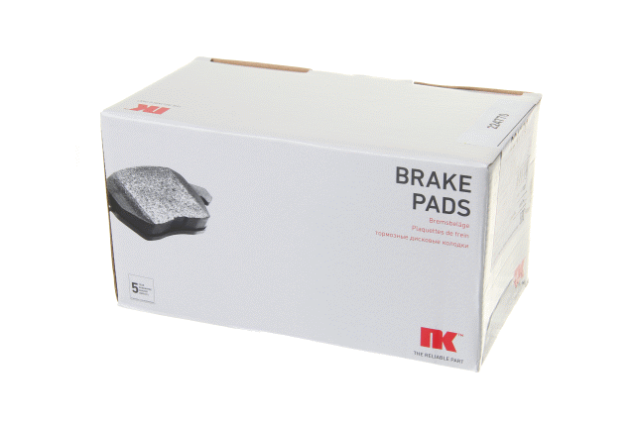
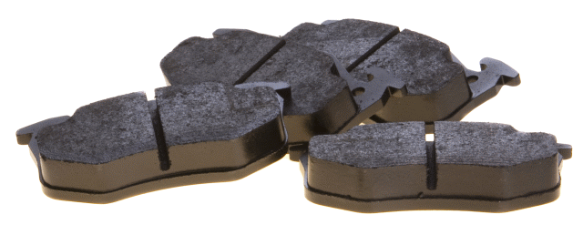
Brake pads
For passenger cars and light commercial vans
European car fleet: > 90%
According to OE dimensions
ECE R90 approved
Excellent brake performance
Long life time
High comfort level

Slide 28
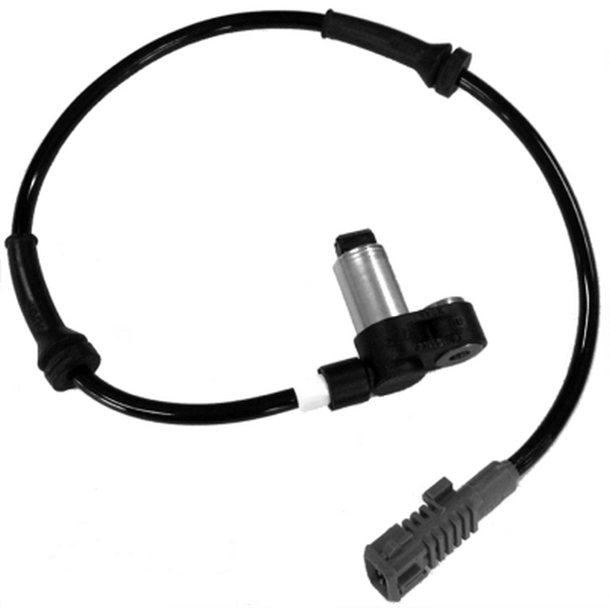
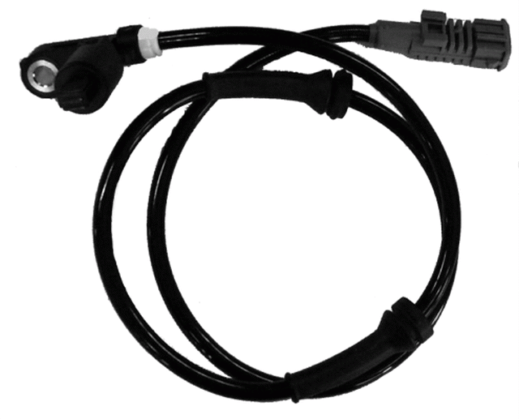
Brake pads – wear indicators

Slide 29
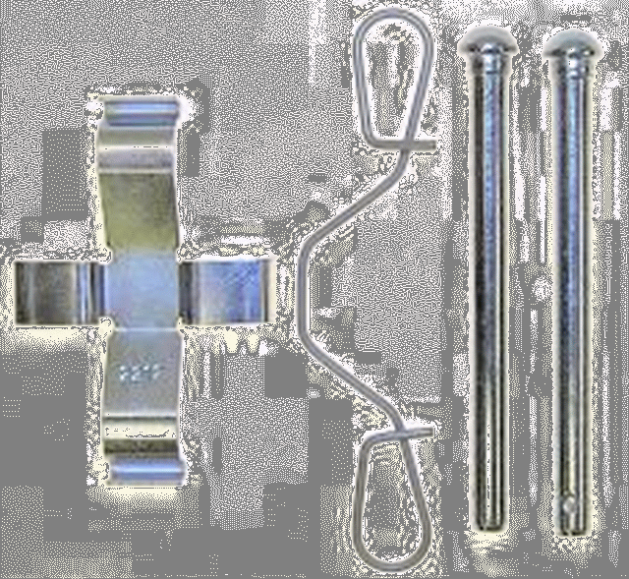
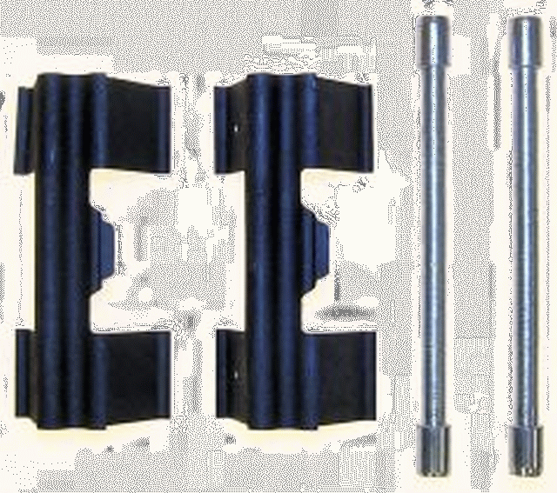
Brake pads – accessory parts

Slide 30
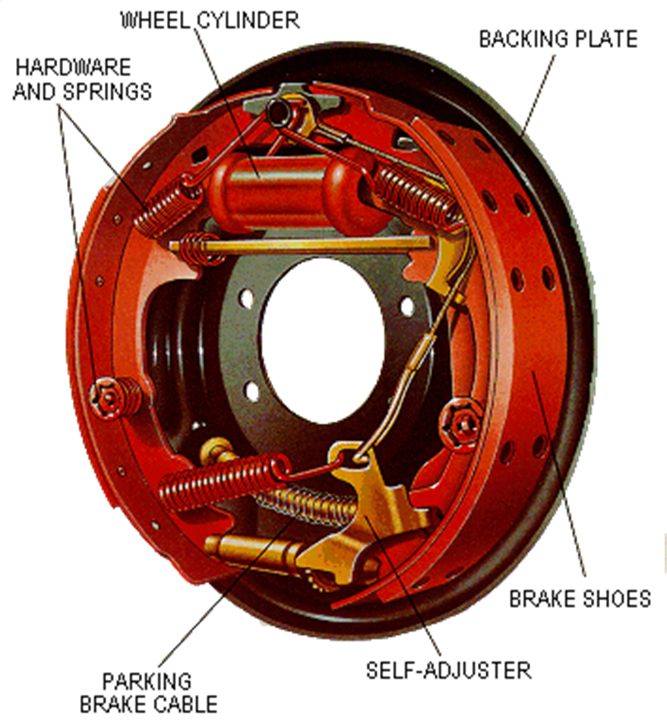
The drum brake system
NK supplies all hydraulic and mechanical wear parts for the drum brake system
http://www.youtube.com/watch?v=bnc3VnQ8kUY

Slide 31
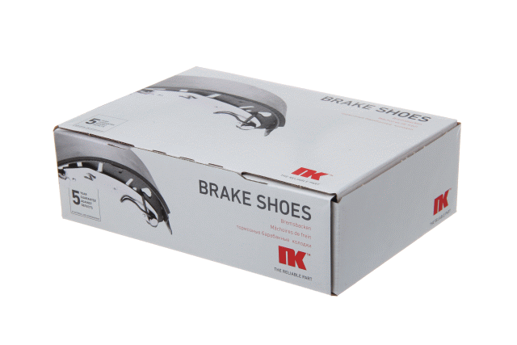
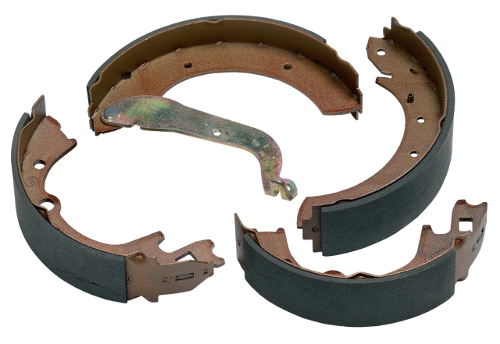
Brake shoes – standard sets
For passenger cars and light commercial vans
European car fleet: > 90% coverage
Rear brake for micro, mini and medium sized models and vans
Service brake / handbrake

Slide 32
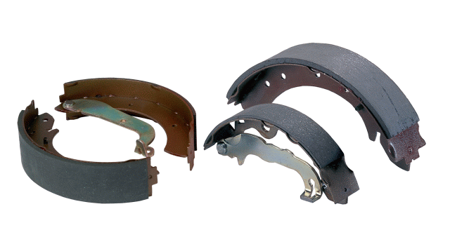
Brake shoe – standard sets
OE dimensions
Equipped according to OE
Lining approved according to ECE90 Packed in axle sets
Packaging concept with 5 box sizes
Boxes sealed (tamper proof) according to Reg 90

Slide 33
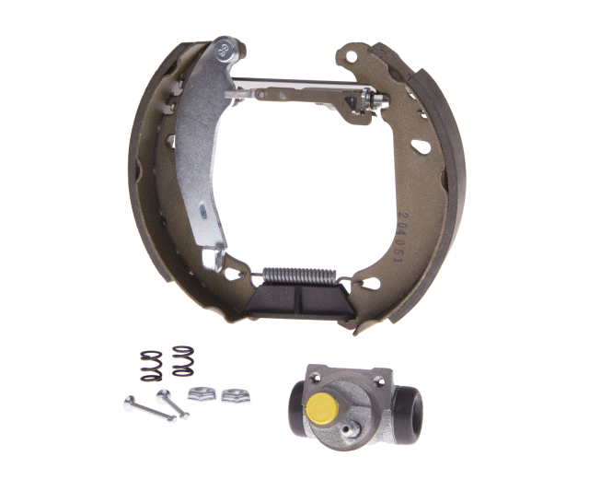
Brake shoes – premounted kits
Comprehensive range for passenger cars and light commercial vans in Europe
Around 250 reference numbers
Manufactured and assembled according to ISO 9001
Homologated according ECE R90
Easy to fit
Ideal for fast fit repairs where time is limited
Saves time
Profitable

Slide 34
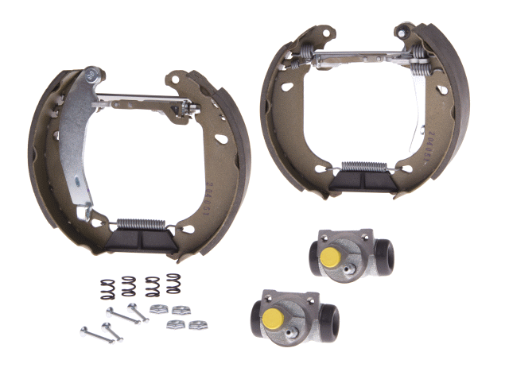
Brake shoes – premounted kits
Adjusters
Brake shoes
Kit parts
Wheel cylinders
Includes all necessary parts for a standard drum brake repair
Packed in axle sets

Slide 35
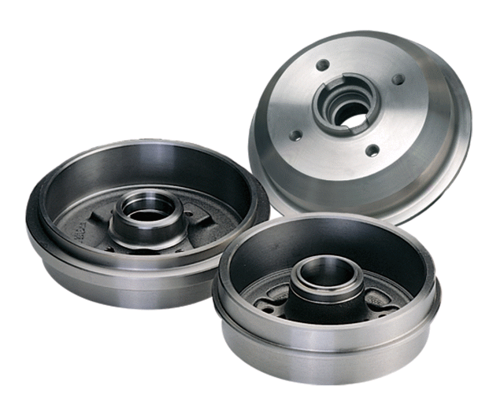
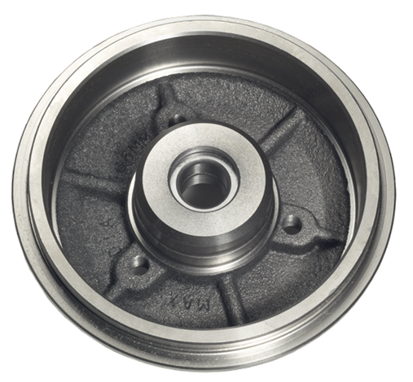
Brake drums
250 drum reference numbers
Passenger cars
Vans < 3,5 t
Drums with ABS rings mounted
Drums with integrated bearing
Dimensions according to OE

Slide 36
Steering parts
Drag links
Track control arms
Tie rod ends
Ball joints
King pin sets
Repair kits
Bushes
Stabiliser bolts
Wheel bearing kits
Steering parts

Slide 37

Steering parts
Safety is paramount!
Steering parts are crucial safety parts
Continuous strain, wear, corrosion can gradually lead to severe damage such as slackness and breakage and can cause serious accidents

Slide 38
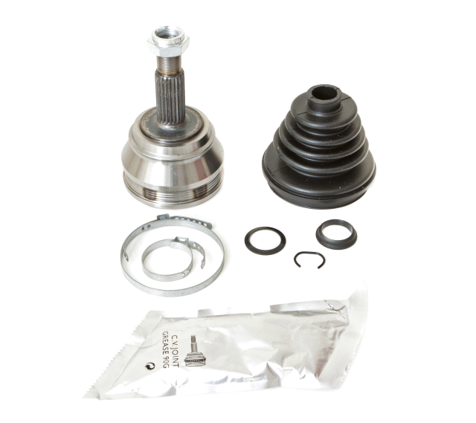
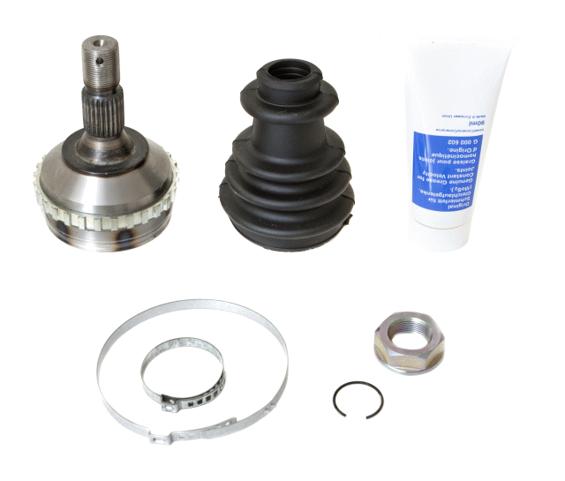
Transmission – CV joints

Slide 39
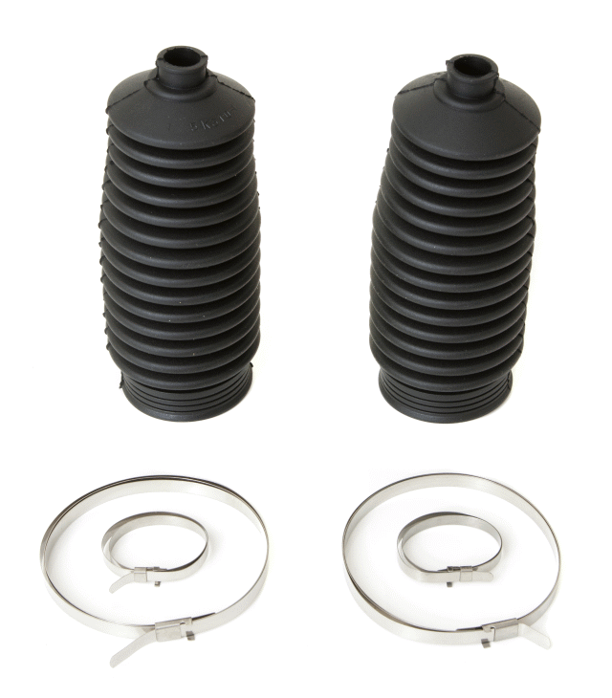
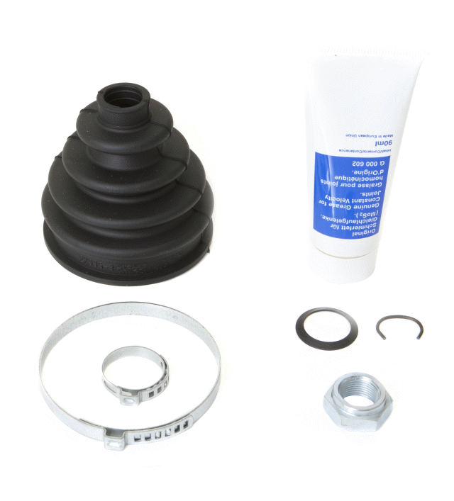
Transmission – CV boot kits

Slide 40
Clutch parts
Clutch kits
Dual mass conversion kits
Conctric slave cylinders
Clutch hydraulics
Clutch parts

Slide 41

Clutch parts
Smooth operation – long lifetime!
Made according to OE dimensions and requirements.
Manufactured on modern specialized machinery under ongoing process control and ISO standards
Friction plates with long lifetime even under tough climate and apllication conditions
Clutch kits
Dual mass flywheel conversion kits
Hydraulics

Slide 42
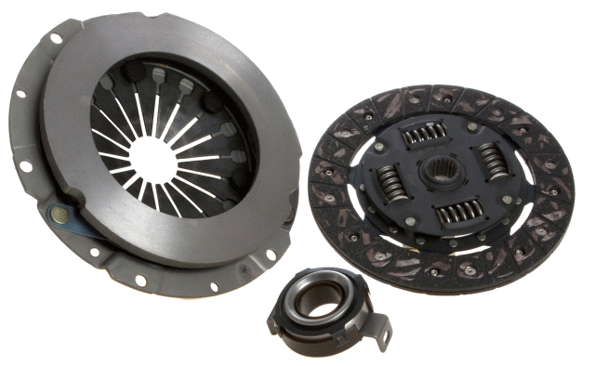
Clutch parts - kits

Slide 43
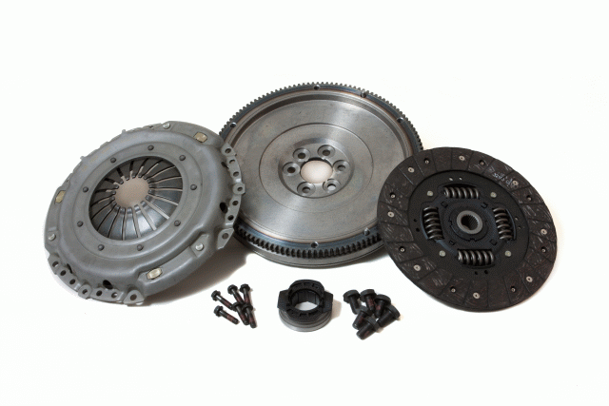
Clutch parts - Dual mass fly wheel
Dual mass fly wheel conversion kits for a number of popular diesel powered car models.
Sturdy and reliable solution
Long life time
Cheaper repair solution
1 set contains:
Solid flywheel
Cltuch kit parts
Fitting bolts

Slide 44
Electrical and Engine components
Starters
Alternators
Timing belt kits
Water pumps
Starter and alternators
Timing belts and water pumps

Slide 45
The nk brand

Slide 46

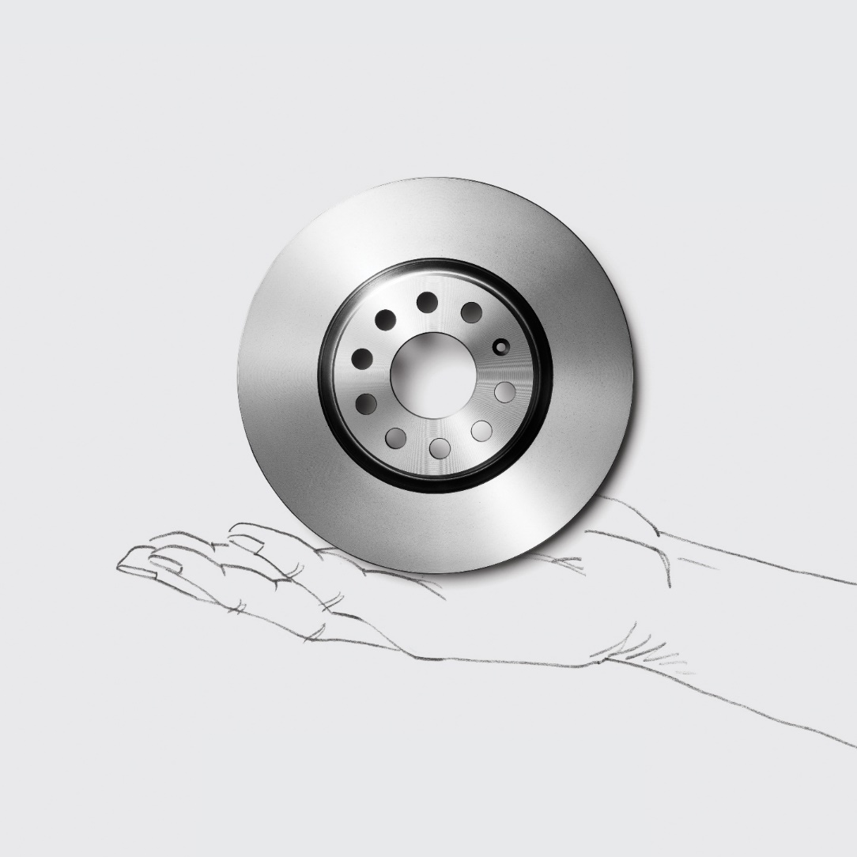

The perfect spare part?
It’s there when you need it.
We want to be the best at providing the spare parts you need. We have one of the market’s widest ranges of brake parts, steering parts and other wear parts. We cover our customers’ spare-parts needs when it comes to cars from 1980 onwards and provide overnight delivery for 95% of the range. Fast, on time – and at the right price. We are there for you when it matters. When quality should simply never be an issue, and when customer complaints are the last thing you need.

Slide 47
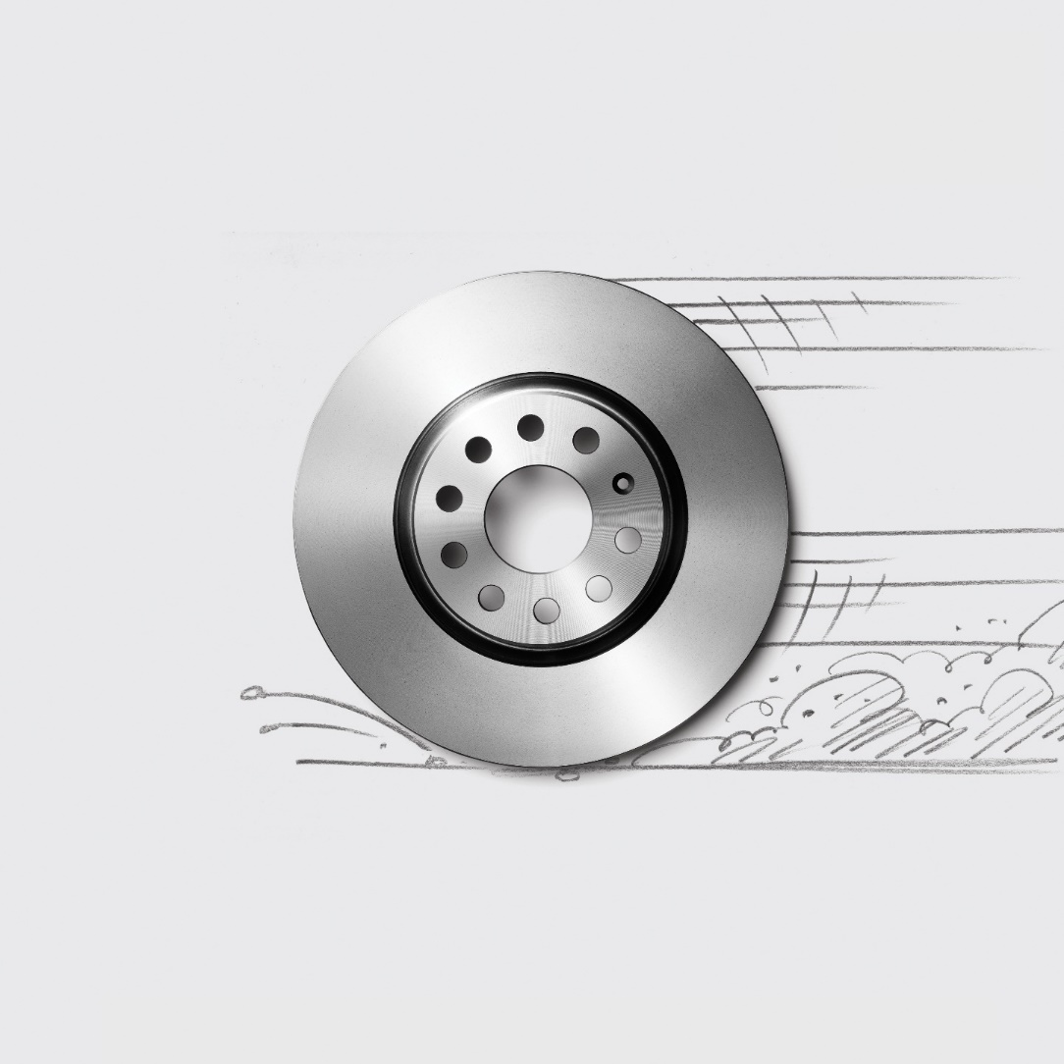
Looks like other top-notch brake discs.
Only difference – you have it tomorrow.
Quality is only valuable if you can get a hold of it. We have one of the market’s widest ranges of brake parts, steering parts and other wear parts – and we provide overnight delivery for 95% of our range.

Slide 48
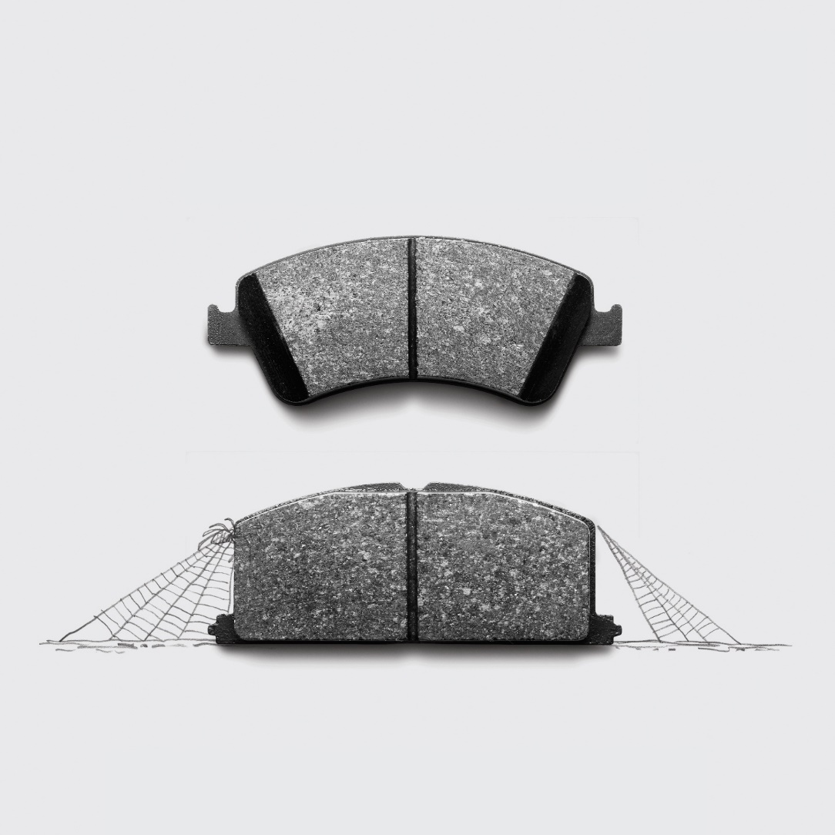
Brake pads for a ’14 Toyota Avensis
– and a ’86 Camry.
It’s good you don’t need to keep
everything in stock.
We have one of the market’s widest ranges of brake parts, steering parts and other wear parts– which we deliver overnight. This helps you to reduce your own stock and puts less than 24 hours between you and your spare part.

Slide 49
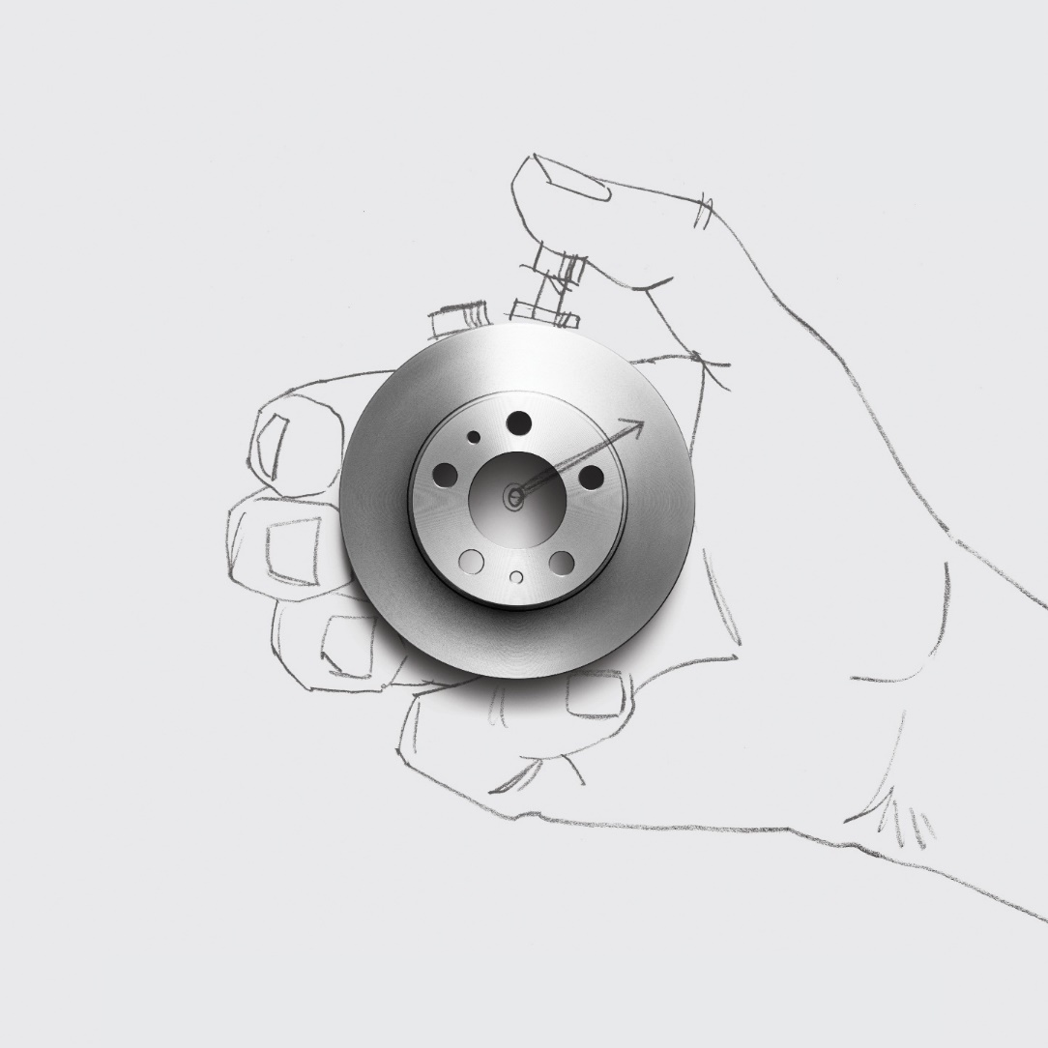
New brake discs for a ’84 Volvo 240?
You’ve got yours in 24 hours!
We have one of the market’s widest ranges of brake parts, steering parts and other wear parts– which we deliver overnight. This helps you to reduce your own stock and puts less than 24 hours between you and your spare part.

Slide 50
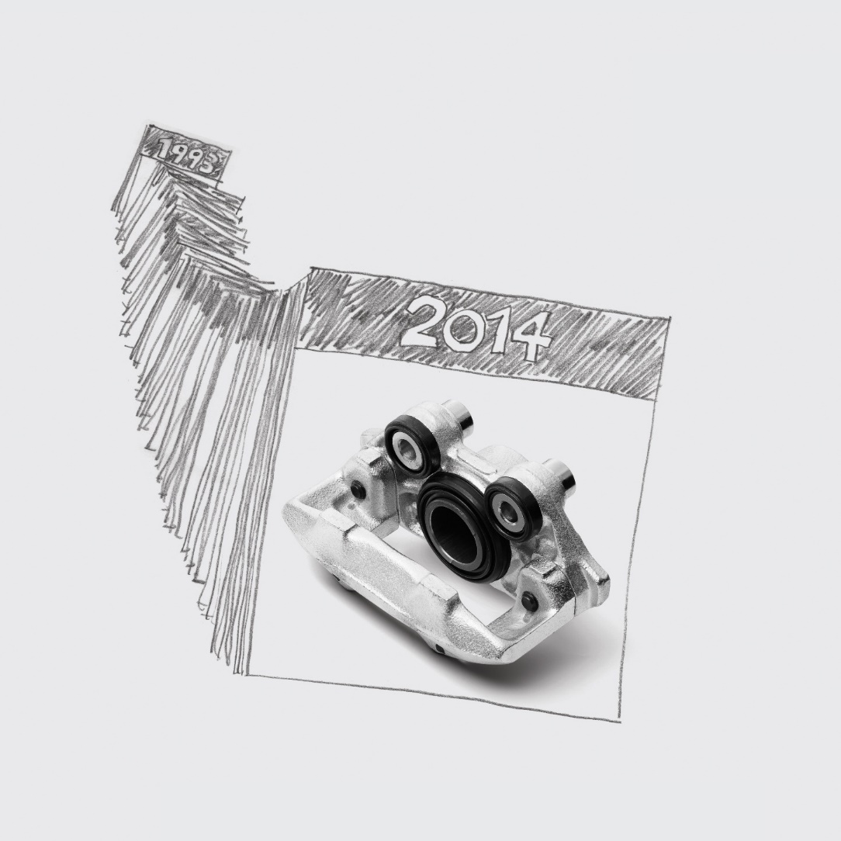
When Opel stopped making
the Kadett E in 1994 –
some of us didn’t.
Good cars can run for decades as long as quality parts are available for them. And they are. We cover cars made since 1980 with one of the market’s widest ranges of brake parts, steering parts and other wear parts – and we deliver 95% of the range overnight.

Slide 51

Have everything in stock.
Without having everything in stock.
With NK as your partner, you can substantially reduce your inventory. Often by up to 30%. We have one of the market’s widest ranges of brake parts, steering parts and other wear parts – which we deliver overnight. This helps you to reduce your own stock and puts less than 24 hours between you and your spare part.

Slide 52

Inventory straps your capital.
Release it.
With NK as your partner, you can substantially reduce your inventory. Often by up to 30%. We have one of the market’s widest ranges of brake parts, steering parts and other wear parts – which we deliver overnight. This helps you to reduce your own stock and puts less than 24 hours between you and your spare part.

Slide 53

487,210 new VW Golfs were sold
in Europe in 2005.
Soon they’ll need new brakes.
We keep an eye on the car market and know what’s on the way. This means that our range always meets the demand – and enables our customers to be fully prepared to meet tomorrow’s needs, too.

Slide 54

Matching Quality.
We guarantee it.
Five-year guarantee against manufacturing and material defects. That’s not asking too much when you want to deliver high quality. Our products are Matching Quality Parts, and are produced according the automotive industry’s TS 16949 or ISO 9001 standards.

Slide 55

Looks like other top-notch steering parts.
Only difference – you have it tomorrow.
Quality is only valuable if you can get a hold of it. We have one of the market’s widest ranges of steering parts, brake parts and other wear parts – and we provide overnight delivery for 95% of our range.

