Slide 1
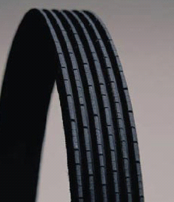


N° 004 11/2014
Automotive spare parts
Rechange automobile
When should we change the accessory belt?
‣ The accessory belts are wear parts with recommendations of replacement varying from 80 000 to 120 000 Km ( from 50 000 to 75 000 miles) depending on the manufacturers.
‣ In certain conditions (city driving) or in a particular environment (strong heat, dust, sand…), the deadline can be shortened. That is why during a visit it is recommended to check the belt.
In case of cracks, wear of teeth → proceed to the replacement of the belt and the tensioners
Cracks
Wear of teeth

